Slide 1
Predicting the hospital length of stay
.

Slide 2
Introduction
Predict Hospital Length of Stay?
Optimized Resource Allocation
Enhanced Patient Care
Reduced Congestion and Wait Times
Data-Driven Decision Making
Improved Operational Efficiency

Slide 3
The datasets
Three datasets:
Data-at-admission.csv
Days-breakdown.csv
Hospital-length-of-stay.csv
Data at admission- consists of personal information of each patient such as age, sex, height, weight and the comorbidities.
Hospital length of stay consists of information such as:
If the patient expired at the hospital
Reason for death
Total length of stay

Slide 4
The datasets
The datasets have been merged on the basis of:
Parent_id on the hospital-length-of-stay.csv
Id on the Data-at-admission.csv
All the data column from dataset Data-at-admission were taken as the independent variables
The column ‘Hospital-length-of-stay’ from the dataset Hospital-length-of-stay was taken as the dependent variable

Slide 5
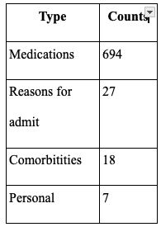
Features
Types of columns:

Slide 6
Handling the null values
Column ‘height’ and ‘weight’ null values were handled by setting the null values as their mean.
Column ‘smoking_history’s null value was handled by filling it with 0 because it was observed that there were 1’s for rows that had a smoking history.
The columns ['year_they_quit','Methylprednisolone Acetate Injectable Suspension Usp','Prozac Capsules','Rybelsus'] were dropped as 'year_they_quit' wasn't seen as a significant column that would provide insight on the model and the rest of the columns had 508 null values.
After this there were 2 two rows that consisted of null values. These were dropped.
Size after handling the null values : 506 rows x 747 columns

Slide 7
Approaches adopted until now
Reducing the dataset by PCA obtaining 85%, 90% and 95% variance and predicting with the help of Lasso Regression
Using Lasso Regression
Using Ridge Regression
Using Logistic Regression
Using Random Forest Regressor
Using Multi Layer Perceptrons

Slide 8
Problems faced
High error in both training and the testing set
Minimum error obtained:
Mean Squared Error train dataset: 37.39640727980008
Ridge regression with alpha value as 1

Slide 9
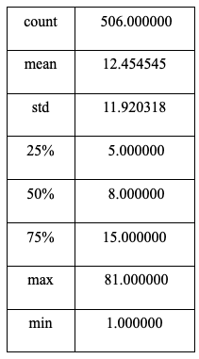
Feature analysis - Hospital length of stay
We divided the dataset into 6 parts to analyze them depending on the length of stay of the columns
20-30 days
30-40 days
40-50 days
50-60 days
60-70 days
70-80 days

